Slide 1

AOLME Curriculum SESSION 5
MATERIALS WERE DEVELOPED BY THE AOLME PROJECT AT THE UNIVERSITY OF NEW MEXICO, PLEASE DO NOT COPY OR DISTRIBUTE ANY OF THESE COPYRIGHTED TASKS WITHOUT PROPER AUTHORIZATION.

Slide 2


Level 1
SESSION 1: Basic of Raspberry PI and Linux-(motivational overview of projects-images, ls, cd, to find and play previous videos) SESSION 2: Introduction to Python (print, for, if) SESSION 3: Algorithms (for loops-arithmetic progressions, if statements-ranges, inequalities) SESSION 4: Binary and Hexadecimal number systems SESSION 5:The Coordinate Plane and Black & White Images in Python SESSION 6: Images and Their Components (histograms) SESSION 7: Creation of Images and Video FINAL PROJECT: VIDEO

Slide 3
The Coordinate Plane and Black & White Images in Python
OBJECTIVES:
Identify the connections between x-y coordinate plane and use of binary numbers to represent black and white images.
Design basic black and white images.
Program binary images using Python.

Slide 4

Selected ACTIVITIES
1. Creating a black and white image using the “Binary Image Generator” (binary colors, open play)
2. Using Coordinates in Black & White Images w/ paper (coordinates, grouping, blocks, share and modify-’debug’)
3. Creating and programming matrices, arrays, and ranges to create images with python (debug, program, share and modify-DMI)

Slide 5

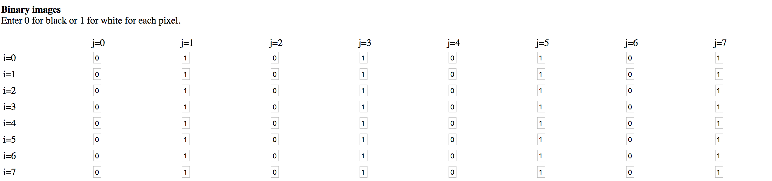
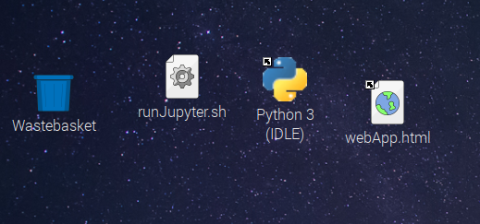




5.1. Creating Images w/ the “Binary Image Generator”
On desktop of laptop, click on “WebApp.html” to open the WebApp using a Browser.
On the WebApp, note that 1 and 0 are linked to the ‘i’ and ‘j’. How are the numbers and the colors in the grid related?
3. On the WebApp, note that you need to press the button ‘Update Image’ to see the last changes. Also, scroll down the App to look at the Python code. What does the code tell you?
4. Discuss & Write: How do you make white and black pixels? Can you make a circle and round corners with the WebApp? Why or why not?
Experiment with the App and create your own black & white image.
To see the pixels, take a pic of the monitor. Then, zoom in the image
AOLME PROJECT - LEVEL 1- SESSION 5 - 2019
MATERIALS DEVELOPED BY THE AOLME PROJECT AT THE UNIVERSITY OF NEW MEXICO, PLEASE DO NOT COPY OR DISTRIBUTE ANY OF THESE COPYRIGHTED TASKS WITHOUT PROPER AUTHORIZATION.

Slide 6

5.1. Creating Images w/ the “Binary Image Generator”
Resources for the Activity
Recommended Steps for the Activity
Activity Card
Folder: /home/pi/AOLME/Session 5/
The “WebApp.html” online
Raspberry Pi and Monitor
Student journal
Make sure the “Binary Image Generator” online is set in the binary (black and white) choice. Students have to set up the ‘size’ of the matrix. Try 10 by 10.
Have students think about how numbers and colors are related.
Let students have fun, play creating images.
Make sure students take turns using the generator and that others pay attention to what is going on in the generator.
Have students debrief what they learned by experimenting with the binary image generator and have them write notes in journal.
Everyone in the team gets to play a role:
Discussion Expert: Leads the team discussion asking questions about what the session is about.
Fair Participation Expert: makes sure of fair participation of everyone.
Hardware Setup/Teardown Expert: in charge of setting up & putting away materials and computer equipment.
Summary Expert: summarizes and records team questions and what the teams has learned.
Activity 1 Goal: Practice and design black and white images using the Image Generator and binary numbers.
AOLME PROJECT - LEVEL 1- SESSION 6- 2018
MATERIALS DEVELOPED BY THE AOLME PROJECT AT THE UNIVERSITY OF NEW MEXICO, PLEASE DO NOT COPY OR DISTRIBUTE ANY OF THESE COPYRIGHTED TASKS WITHOUT PROPER AUTHORIZATION

Slide 7
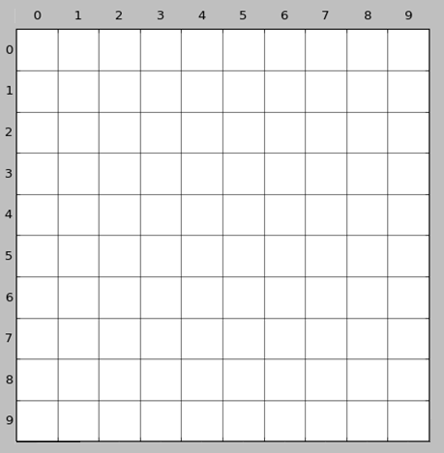




5.2. Using Coordinates in Black & White Images
1. Create a figure by filling in complete squares with black in the given grid.
2. After completing the image, notice how each square, or pixel, has a specific position.
How is this coordinate system different from what you have studied in your math class?
How is a grid related to a coordinate plane?
And, how are both of these similar to or different from the ‘i’-‘j’ grid we used in the WebApp?
name each pixel like this:
3R–1C
3. Find a partner in your group and have him/her draw the same as your image but without looking at your sheet. Tell your partner only the coordinates to color.
4. Would there be a way of telling your partner the information for the parts of the image you created in a briefer way other than pixel by pixel?
3R-1C
AOLME PROJECT - LEVEL 1- SESSION 5- 2019
MATERIALS DEVELOPED BY THE AOLME PROJECT AT THE UNIVERSITY OF NEW MEXICO, PLEASE DO NOT COPY OR DISTRIBUTE ANY OF THESE COPYRIGHTED TASKS WITHOUT PROPER AUTHORIZATION.

Slide 8
5.2. Using Coordinates in Black & White Images
Resources for the Activity
Recommended Steps for the Activity
Activity Card
Hand out with coordinate plane, 2 per team member
One thick pencil per team member
Make sure that each student comes up with own image and encourage them to be creative and not worry about being perfect.
Model and practice with students how to name the coordinates. Emphasize the order of RC, rather than the other way around.
Discuss how the order of x and y (columns and row) is different from regular coordinates they learn at school.
Emphasize not showing images to partners before telling the coordinates to one another.
As students are telling images to one another, if they go pixel by pixel, ask them whether there would be a quicker/ more efficient way to tell the coordinates.
Everyone in the team gets to play a role:
Discussion Expert: Leads the team discussion asking questions about what the session is about.
Fair Participation Expert: makes sure of fair participation of everyone.
Hardware Setup/Teardown Expert: in charge of setting up & putting away materials and computer equipment.
Summary Expert: summarizes and records team questions and what the teams has learned.
Activity 2 Goal: Identify the connections between x-y coordinate plane and use of binary numbers to represent black and white images.
AOLME PROJECT - LEVEL 1- SESSION 4- 2018
MATERIALS DEVELOPED BY THE AOLME PROJECT AT THE UNIVERSITY OF NEW MEXICO, PLEASE DO NOT COPY OR DISTRIBUTE ANY OF THESE COPYRIGHTED TASKS WITHOUT PROPER AUTHORIZATION

Slide 9
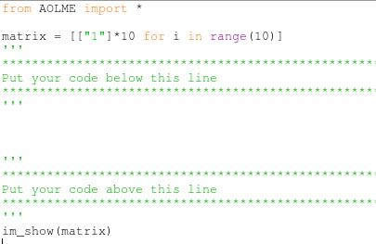
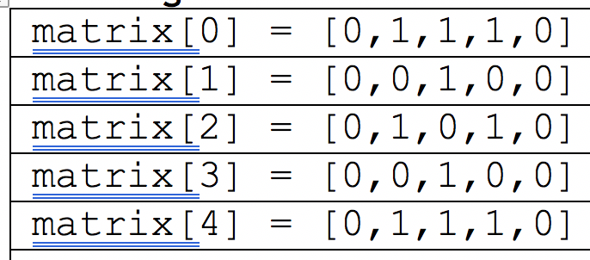
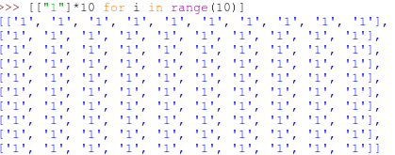
5.3. Programming images with Python
1. Open the file: /home/pi/AOLME/Session 5/BWex.py
2. Analyze the illustrations a-c below and predict what would be their image or code. Discuss in your team the size of each image and what each imagine would look like.
← Here we import the AOLME library.
← This creates a blank matrix!
(a)
Explain line-by-line the code in this area.
Change the code and see what happens.
(b)
← Your code goes here!
(c)
← This function defined in AOLME.py lets us see the matrix you created.
3. Open: /home/pi/AOLME/Session 5/Bw1.py. Explore what the code does.
4. Design and program in your team an image that represents your team. Take turns typing in the codes. Save it using a funny name. Then, show your image to another group.
from AOLME import *
matrix = [["1"]*10 for i in range(10)]
for row in range(10):
matrix[row][4] = "0"
for col in range(10):
matrix[0][col] = "0"
im_show(matrix)
Think: If you create a rectangle (vertical or horizontal), what would be the fastest way to code or program it?
Before running the program and showing the image, predict what would it look like. If you change the ranges, what happens?
AOLME PROJECT - LEVEL 1- SESSION 5- 2019
MATERIALS DEVELOPED BY THE AOLME PROJECT AT THE UNIVERSITY OF NEW MEXICO, PLEASE DO NOT COPY OR DISTRIBUTE ANY OF THESE COPYRIGHTED TASKS WITHOUT PROPER AUTHORIZATION.

Slide 10
5.3. Programming Images with Python
Resources for the Activity
Recommended Steps for the Activity
Activity Card
Folder: /home/pi/AOLME/Session 5/BW1.py and file called “BW1.py”
File: /home/pi/AOLME/Session 5/Bwex.py of an image previously done by AOLME students
File: /home/pi/AOLME/Session 5/BW2.py. To practice making squares and ranges
Hand out with coordinate plane to design team’s image
Raspberry Pi Kit/ Student Journal
Have students observe, think about, and play with the codes provided in the files. The goal of these files is to focus on experimenting to learn what each code or command does.
Talk about each line of code and how they are all related.
Prediction of images and black and white image should focus on link between numbers, pixels, and colors.
When modifying AOLME students’ image, suggest starting with small changes and running the program, so they become familiar with the code.
Let students have fun creating images and encourage creativity.
When creating team’s image use team’s name as a prompt or initial ideas and have them take turns entering codes.
Have students debrief what they learned in the session and take notes on journal.
Everyone in the team gets to play a role:
Discussion Expert: Leads the team discussion asking questions about what the session is about.
Fair Participation Expert: makes sure of fair participation of everyone.
Hardware Setup/Teardown Expert: in charge of setting up & putting away materials and computer equipment.
Summary Expert: summarizes and records team questions and what the teams has learned.
Activity 3 Goal: Program binary images with Python using the Raspberry Pi.
AOLME PROJECT - LEVEL 1- SESSION 5- 2018
MATERIALS DEVELOPED BY THE AOLME PROJECT AT THE UNIVERSITY OF NEW MEXICO, PLEASE DO NOT COPY OR DISTRIBUTE ANY OF THESE COPYRIGHTED TASKS WITHOUT PROPER AUTHORIZATION.

